Slide 1
Online Beauty Shop
Name: Maharin Khondoker
Principles of Database Systems
Final 2025

Slide 2
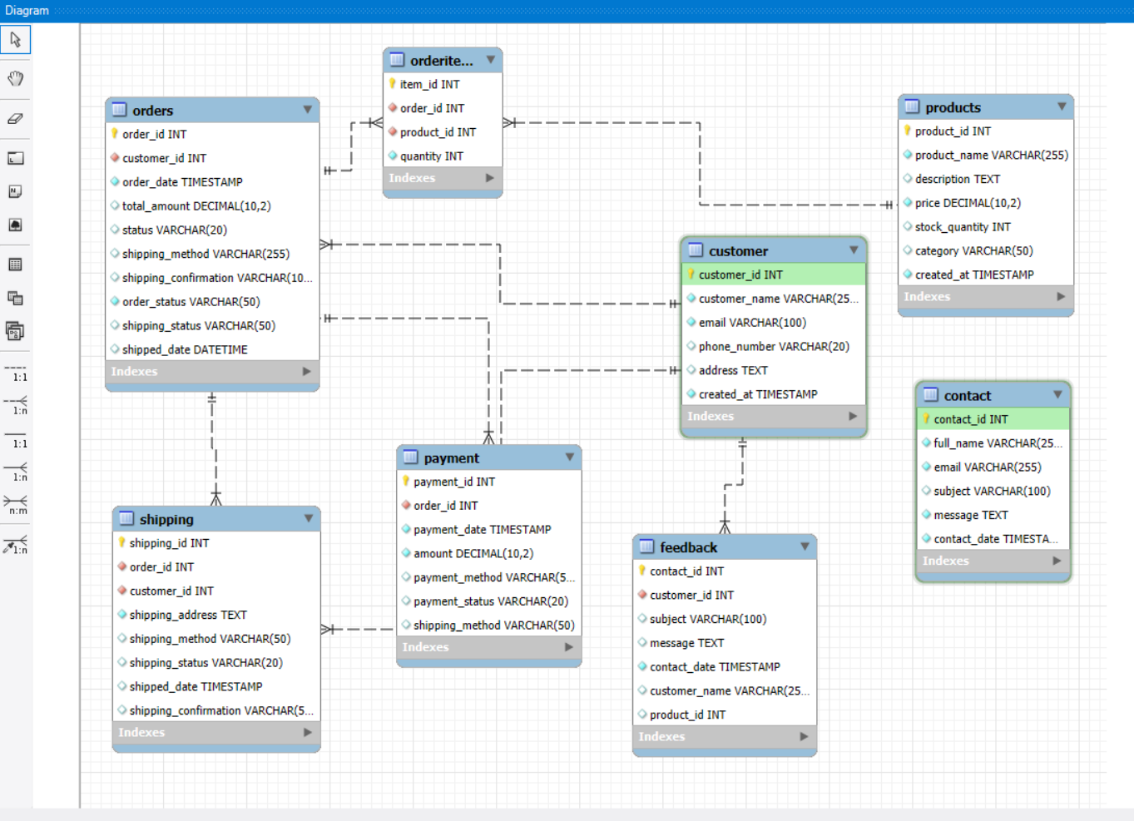
ER Diagram

Slide 3
Making Database and Table
Created onlinebeauty database using phpMyAdmin.
Built 7 tables: Customer, Products, Orders, OrderItems, Payment, Shipping, Feedback.
Used SQL queries to define tables and relationships.
Applied primary & foreign keys to ensure data integrity.
Designed for an e-commerce beauty store system.

Slide 4
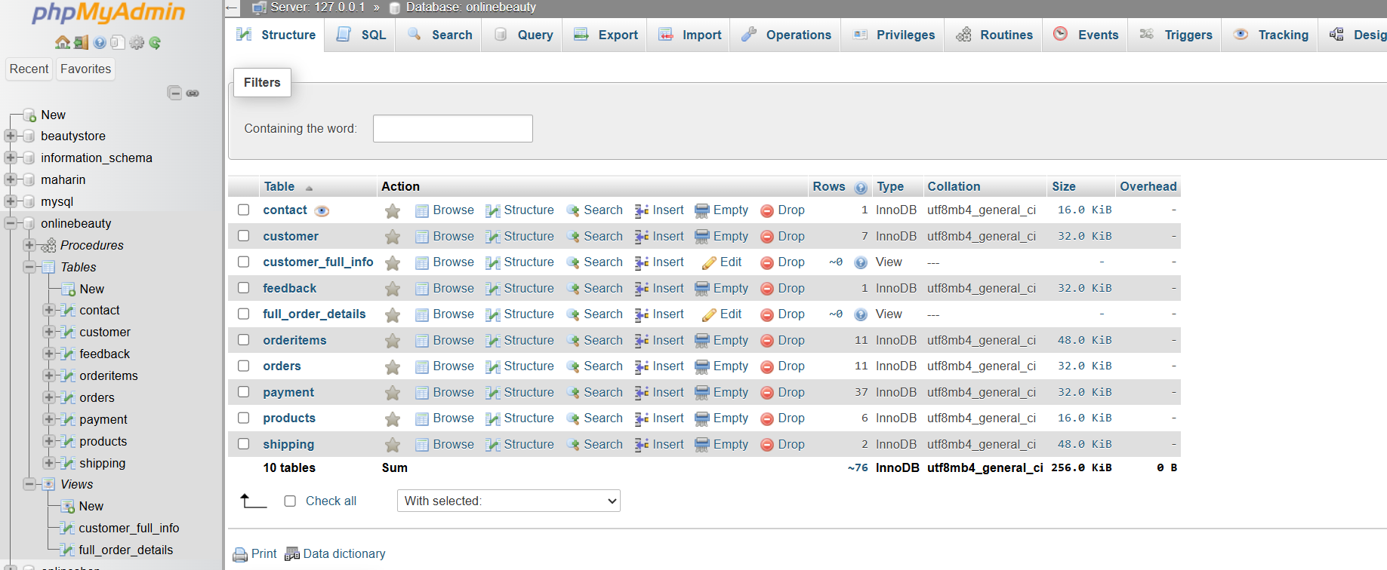
Table Creation

Slide 5
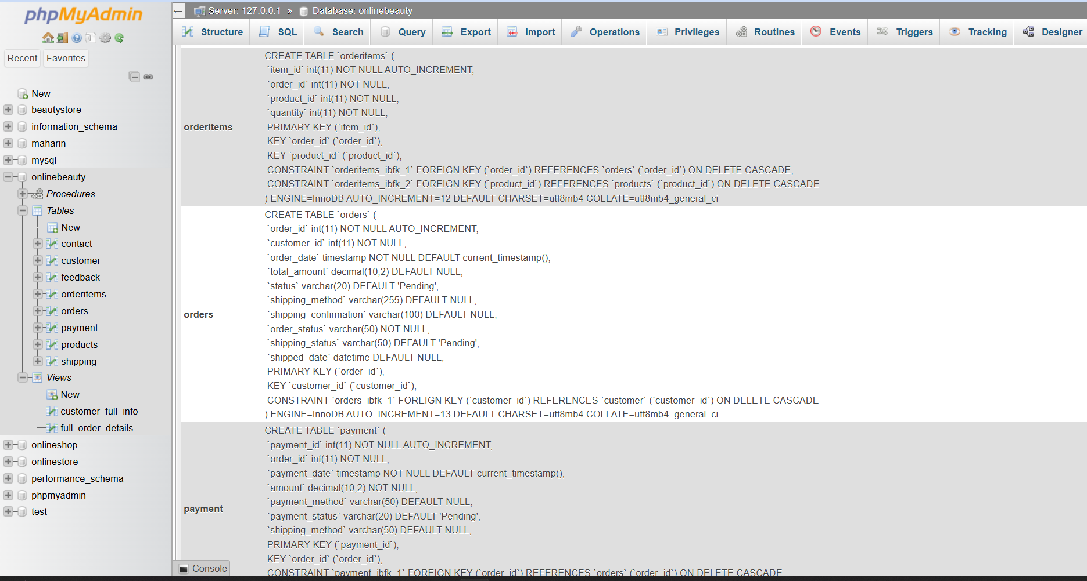
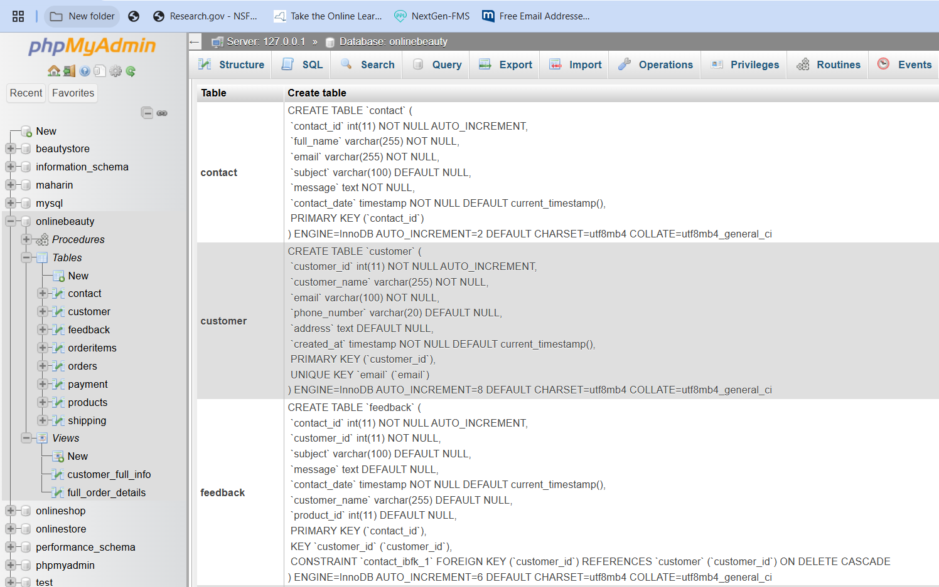
SQL Code

Slide 6
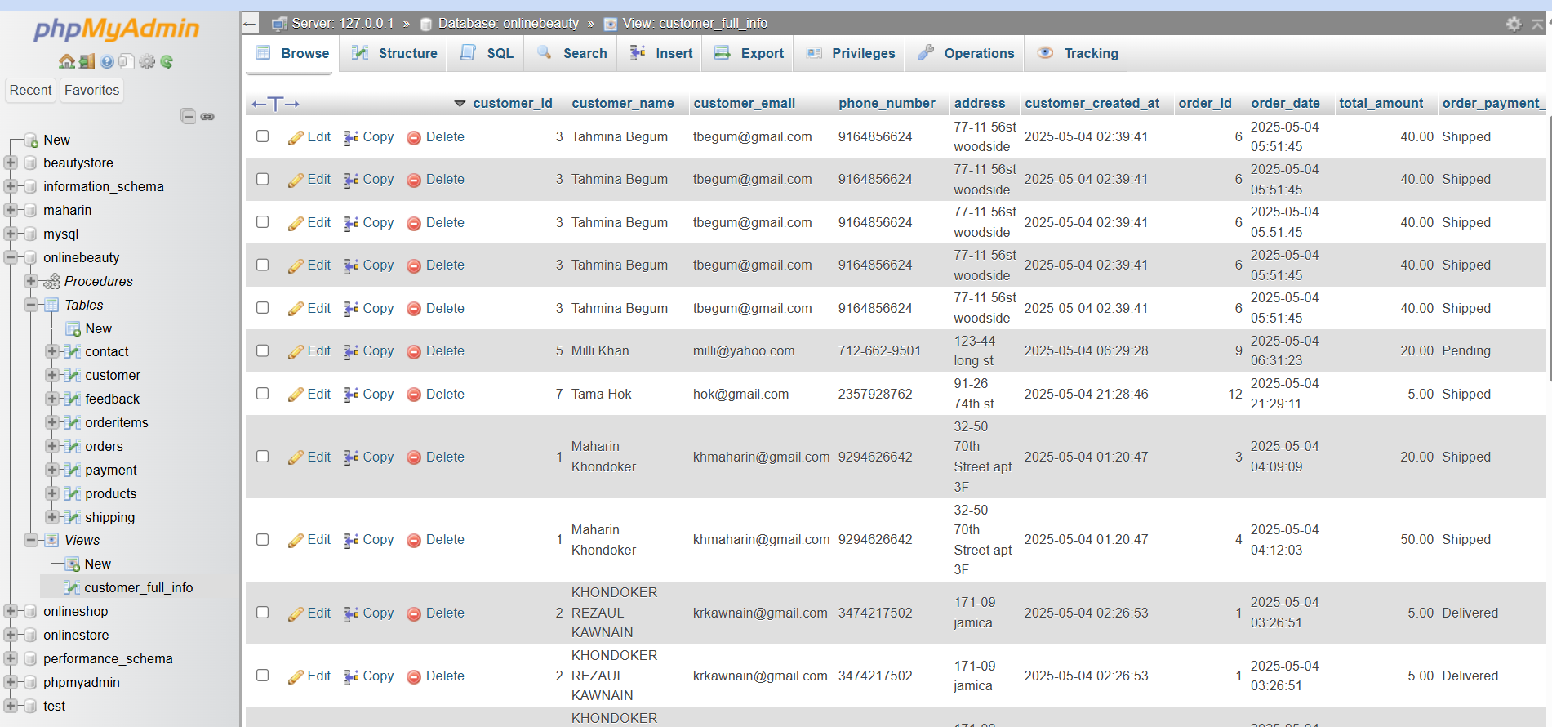
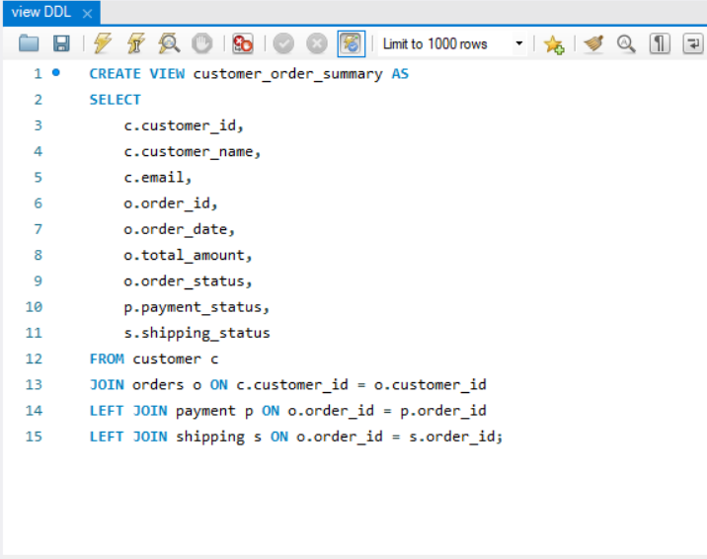
View DDL

Slide 7
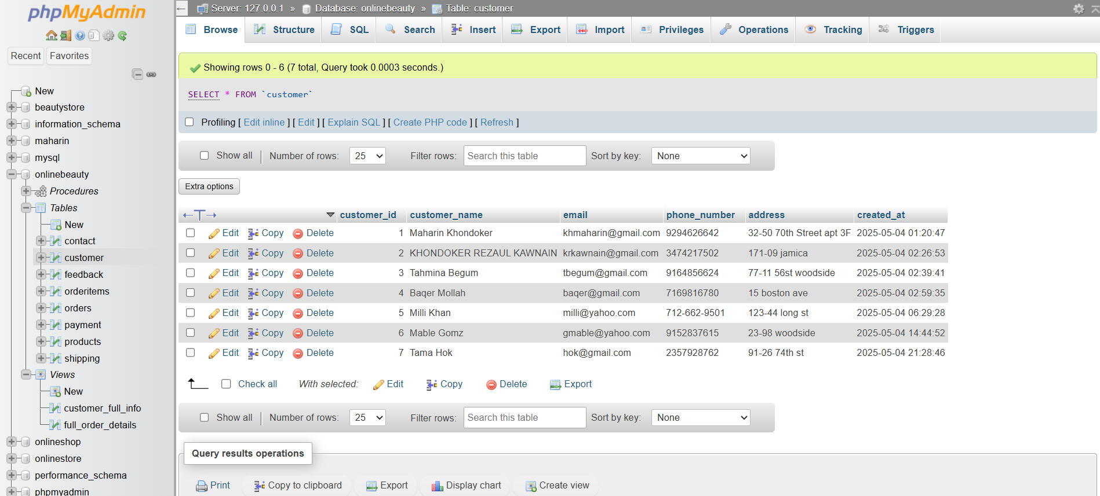
Structure of Customer Table

Slide 8
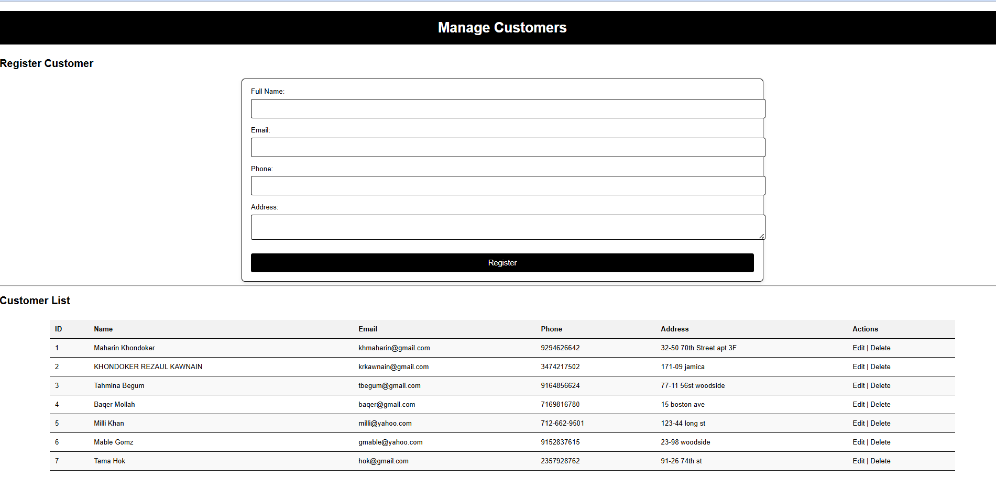
Frontend of customer Table

Slide 9
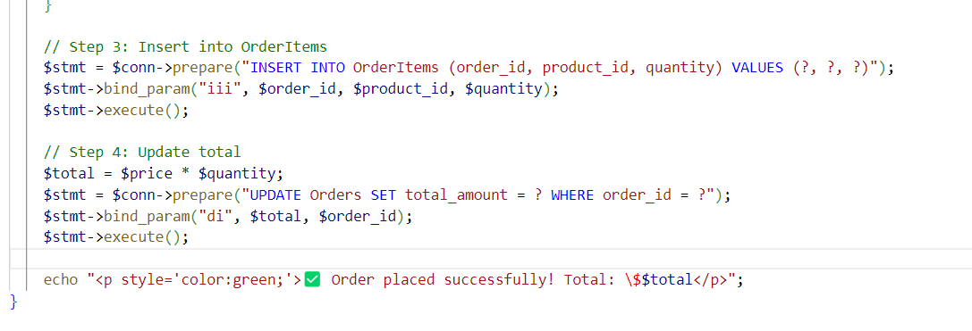
Function DDL code

Slide 10
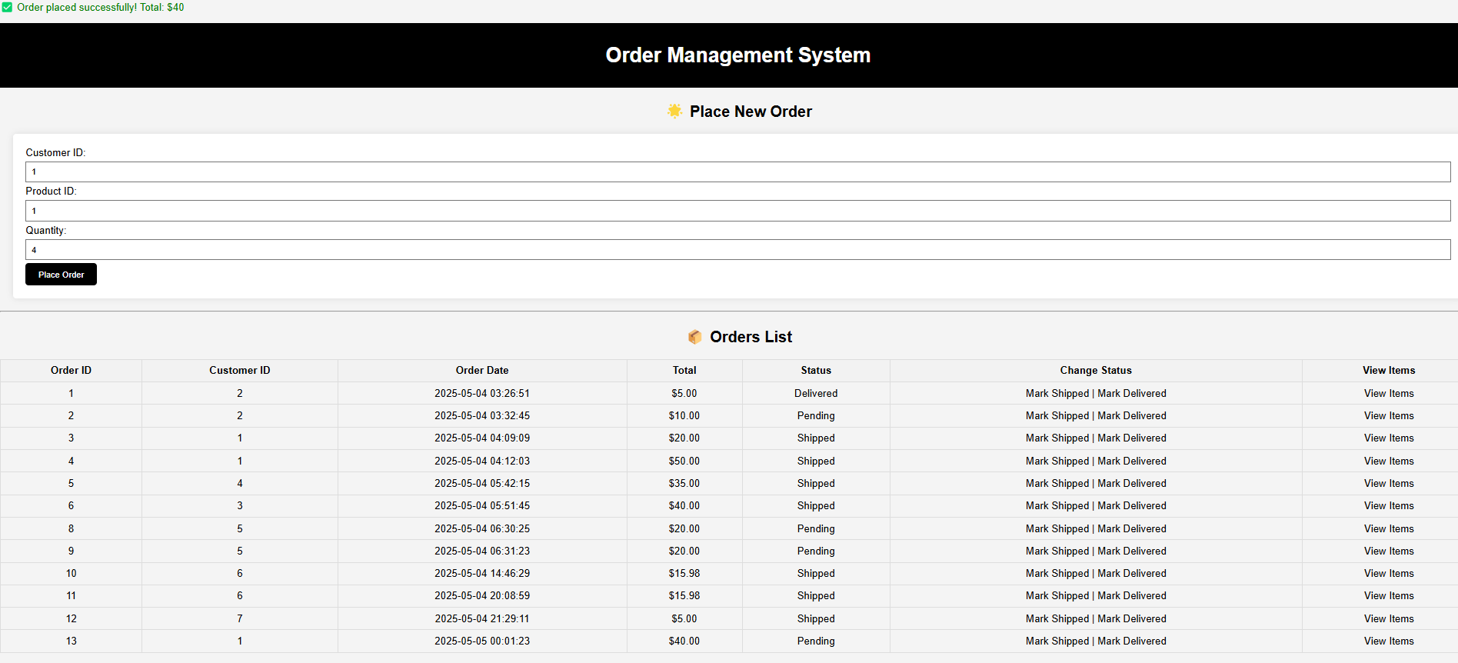
Function DDL Represent in Order Table

Slide 11
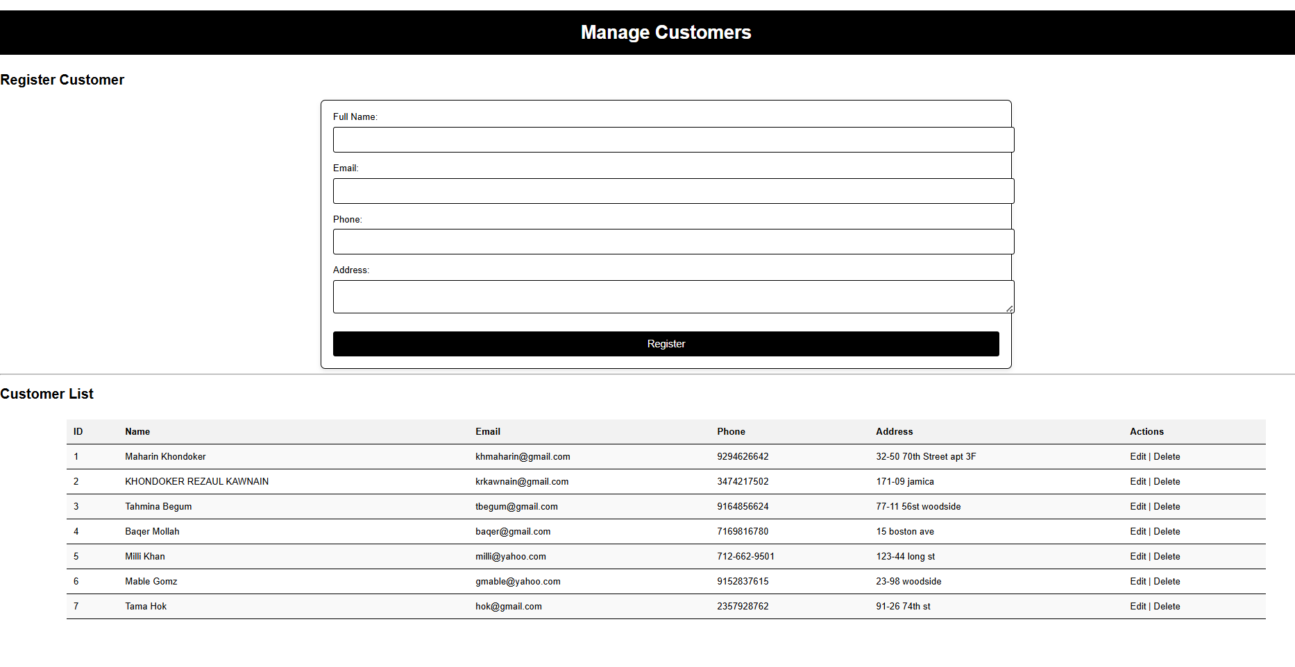
Trigger DDL

Slide 12
Normalization
1NF (First Normal Form):
Atomic values in columns.
Each row has a unique primary key.
2NF (Second Normal Form):
No partial dependency on primary key.
Foreign keys define relationships.
3NF (Third Normal Form):
No transitive dependencies.
Non-key columns depend only on the primary key.

Slide 13
Isolation Level
Read Committed
Where: Payment, Orders, Shipping.
Why: Ensures no dirty reads. Useful for avoiding partial/invalid data reads during payment or order updates.
Repeatable Read
Where: OrderItems, Products.
Why: Prevents quantity mismatch or stock changes while processing a customer order.
Serializable
Where: Customer and Feedback insertions.
Why: Ensures full consistency. Prevents duplicate customer entries and race conditions during feedback logging.

Slide 14
Integrity Enforcement – Where & Why
Primary Keys
Where: All tables (e.g., customer_id, product_id)
Why: Uniquely identifies each record. Ensures no duplicates.
Foreign Keys
Where: orders.customer_id, orderitems.product_id, etc.
Why: Enforces referential integrity—data must exist in the referenced table.
Unique Constraints
Where: customer.email
Why: Prevents duplicate customer registrations with same email.
Not Null Constraints
Where: Key fields like customer_name, price, quantity
Why: Ensures essential data is always present.
Default Values
Where: status, shipping_status
Why: Provides consistent initial values to avoid null logic errors.

Slide 15
Form ( Delete, Edit/Update, Add)

Slide 16
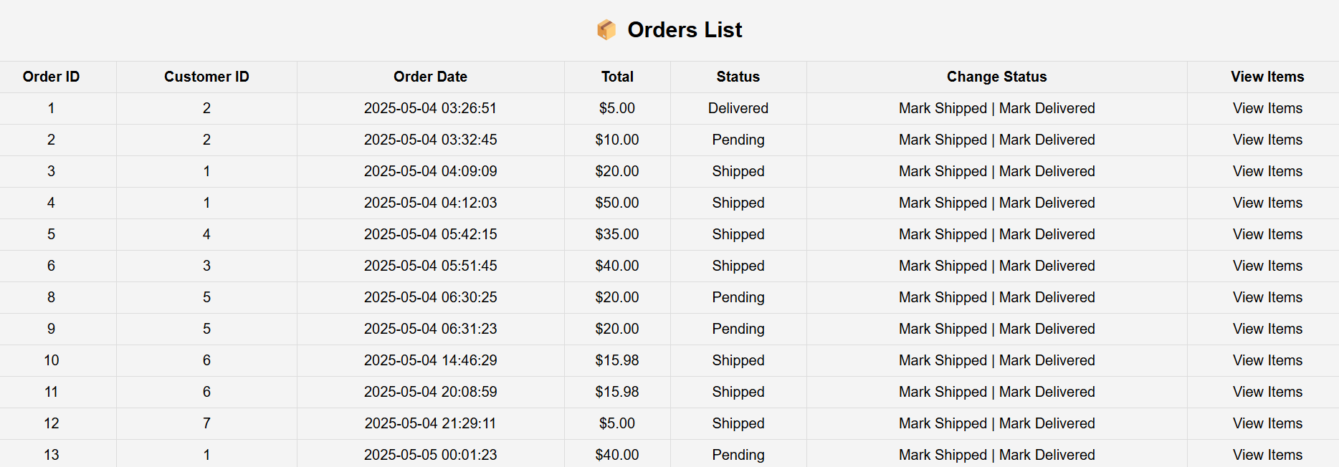
Report for a day

